Slide 1
Our Founders
The Delta Kappa Gamma Society International
Notes:
Introduction
“We salute the twelve founders of The Delta Kappa Gamma Society International. We honor them for their clarity of vision, for enduring faith in that vision, for the fortitude with which they held the course. We recognize their courage as breakers of precedents. We acknowledge our debt to them for enriched professional lives.”
Edna McGuire Boyd

Slide 2
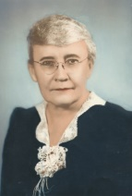
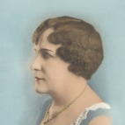
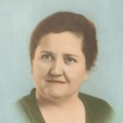
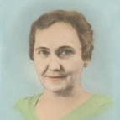
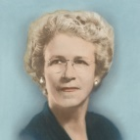
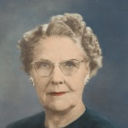
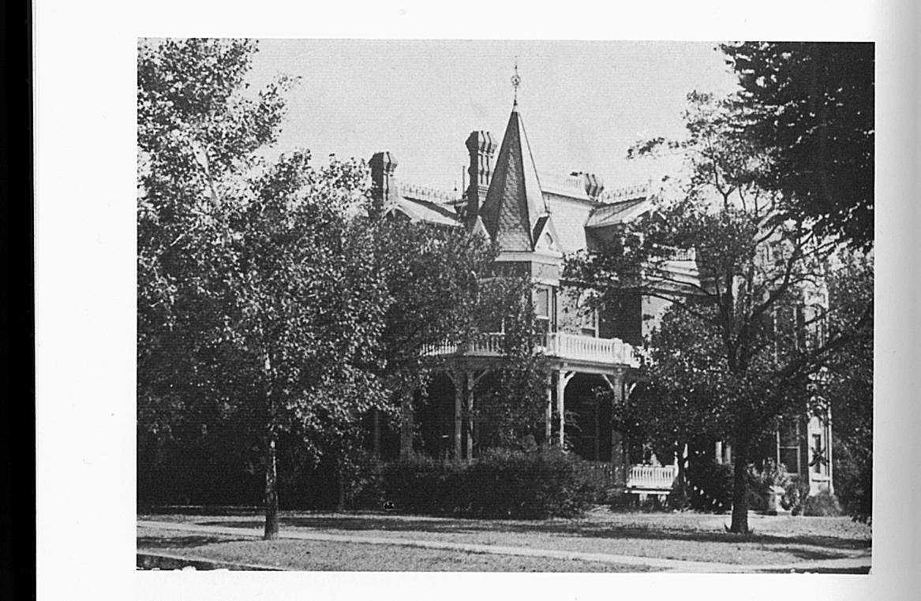
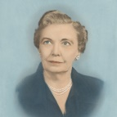
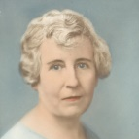
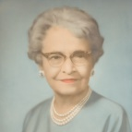
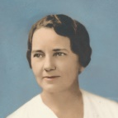
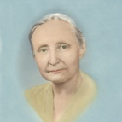
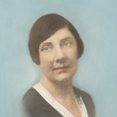
Our Founders
We salute the 12 Founders of The Delta Kappa Gamma Society International. We honor them for their
Clarity of vision
Enduring faith in that vision
Fortitude with which they held the course
Courage as breakers of precedents
We acknowledge our debt to them for enriched personal lives.
(Edna McGuire Boyd)

Slide 3
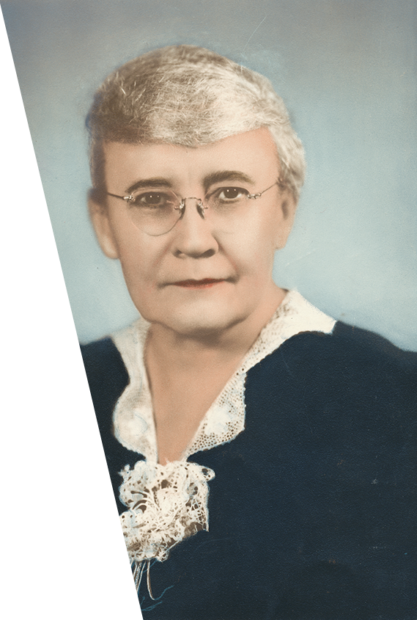
Annie Webb Blanton
Our Founders
August 19, 1870-October 2, 1945
Notes:
Dr. Annie Webb Blanton

Slide 4
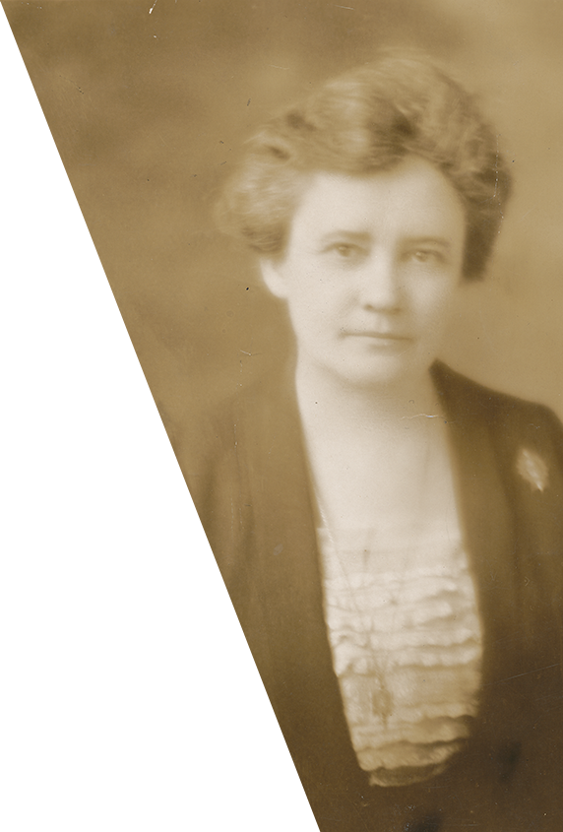
Annie Webb Blanton
Our Founders
Taught in one-room school, elementary school, high school, “normal” school, university
Elected first woman president of Texas State Teachers Association
Became the first woman elected to statewide office in Texas: State Superintendent of Instruction
  Free textbooks
  54% increase in teacher salaries
  Improvement of rural schools
Loved gardening, cooking, reading mysteries, and collecting miniature donkeys
Notes:
Dr. Annie Webb Blanton began her career as the one teacher in a rural school at age 17, later earning her Bachelor in Literature at the University of Texas. After teaching in Austin for several years, she went to North Texas Normal School as Associate Professor to teach for 17 years; the grammar text she wrote became a mainstay for her students. She finished her career at the University of Texas as chair of the Department of History and Education after completing her Ph.D. in rural education at Cornell University.
Always active in professional organizations, Dr. Blanton was the first woman elected president of the Texas State Teachers Association in 1916.
In 1918 she became the first woman to break the female political barrier when she was elected State Superintendent of Instruction. A few of the many achievements while in this position included doubling financial support for public schools, creating a system for free textbooks, improving rural schools and increasing teachers’ salaries.
She enjoyed growing roses, cooking, reading mysteries and collecting miniature donkeys. She dearly loved her nieces and nephews and her friends and rarely turned down a request from one of them.

Slide 5
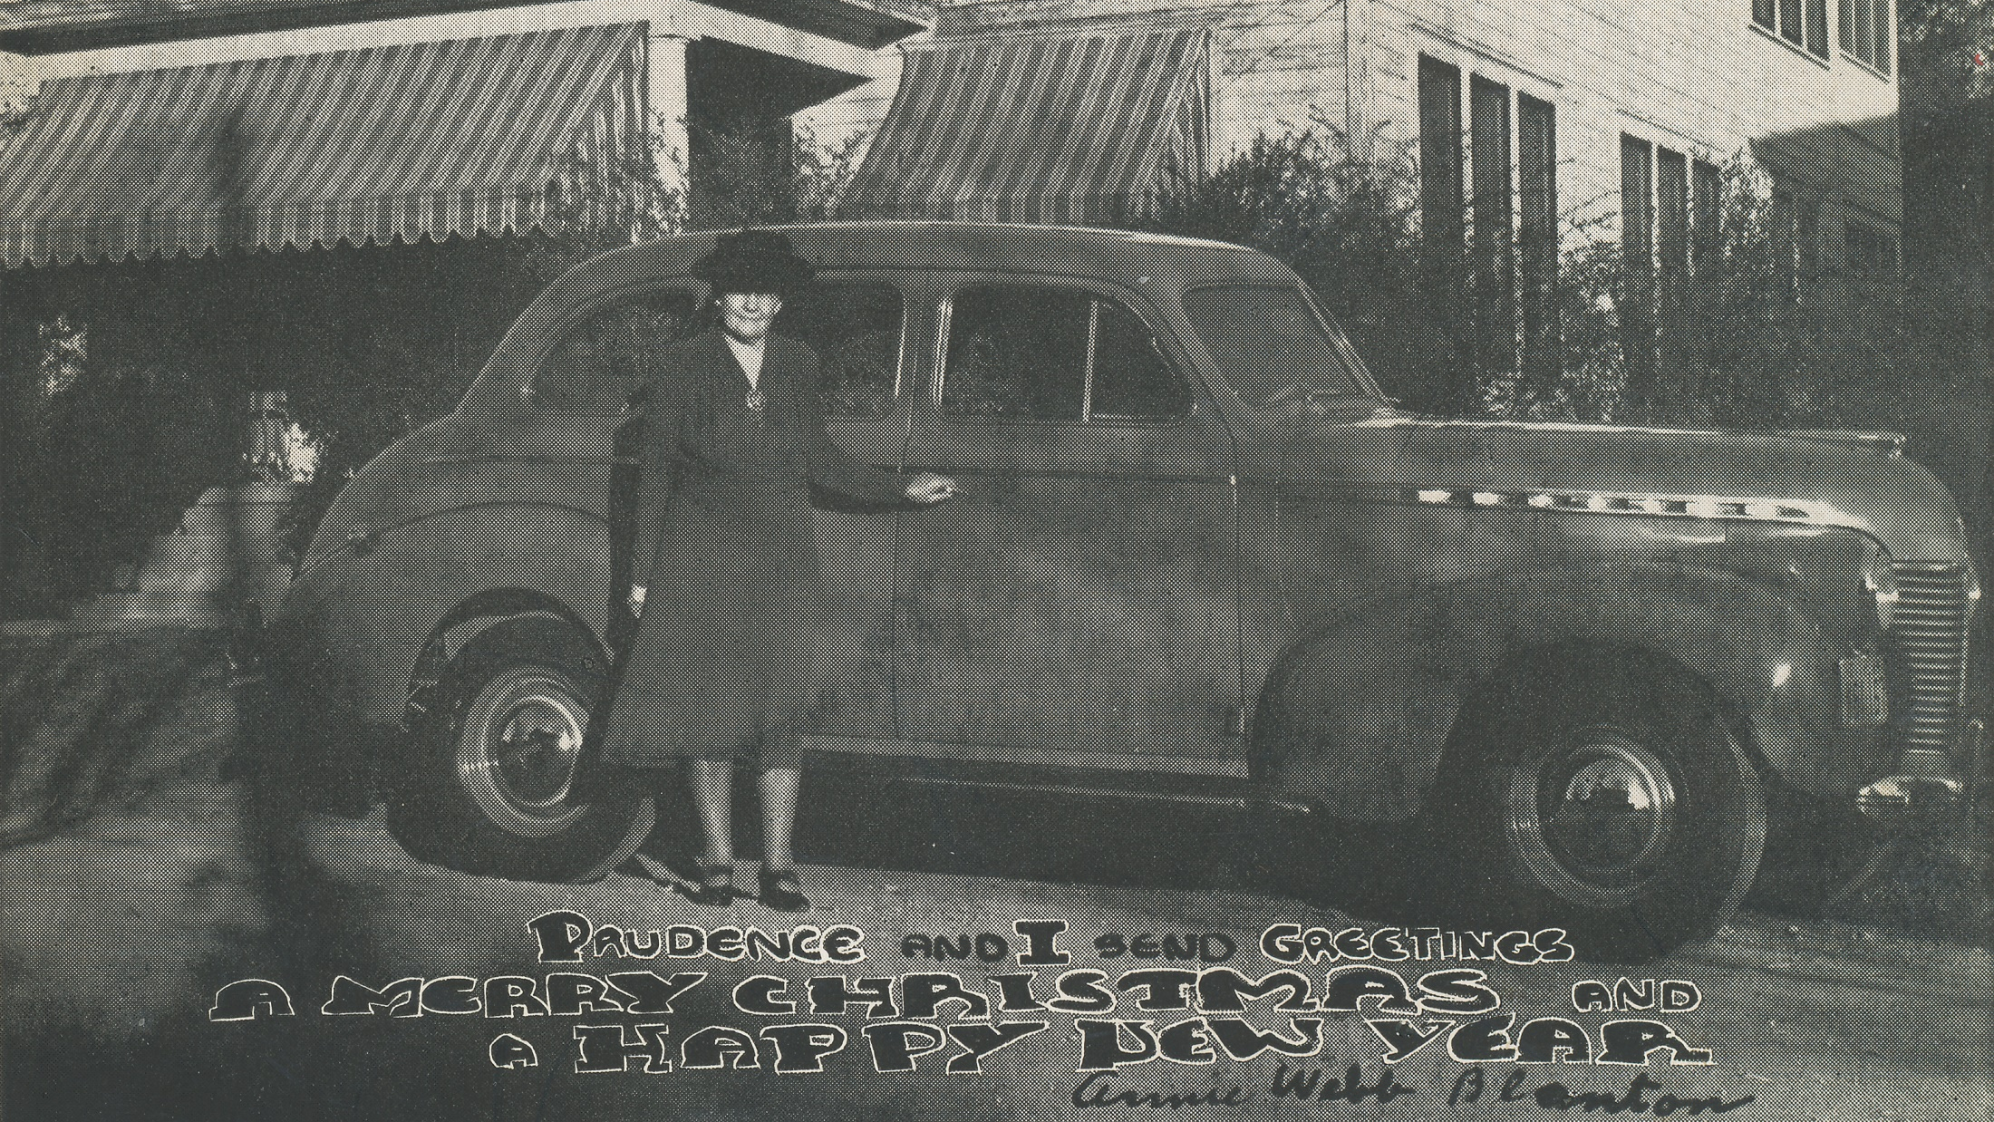

Slide 6
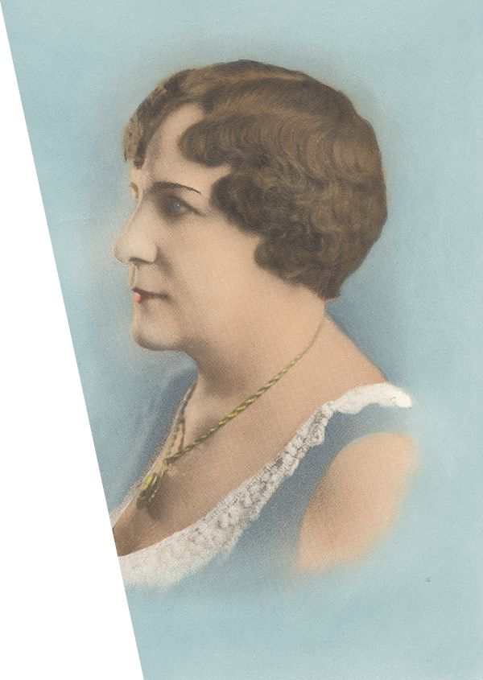
Mamie Sue Bastian
Our Founders
November 27, 1875-February 20, 1946
Notes:
Mamie Sue Bastian

Slide 7
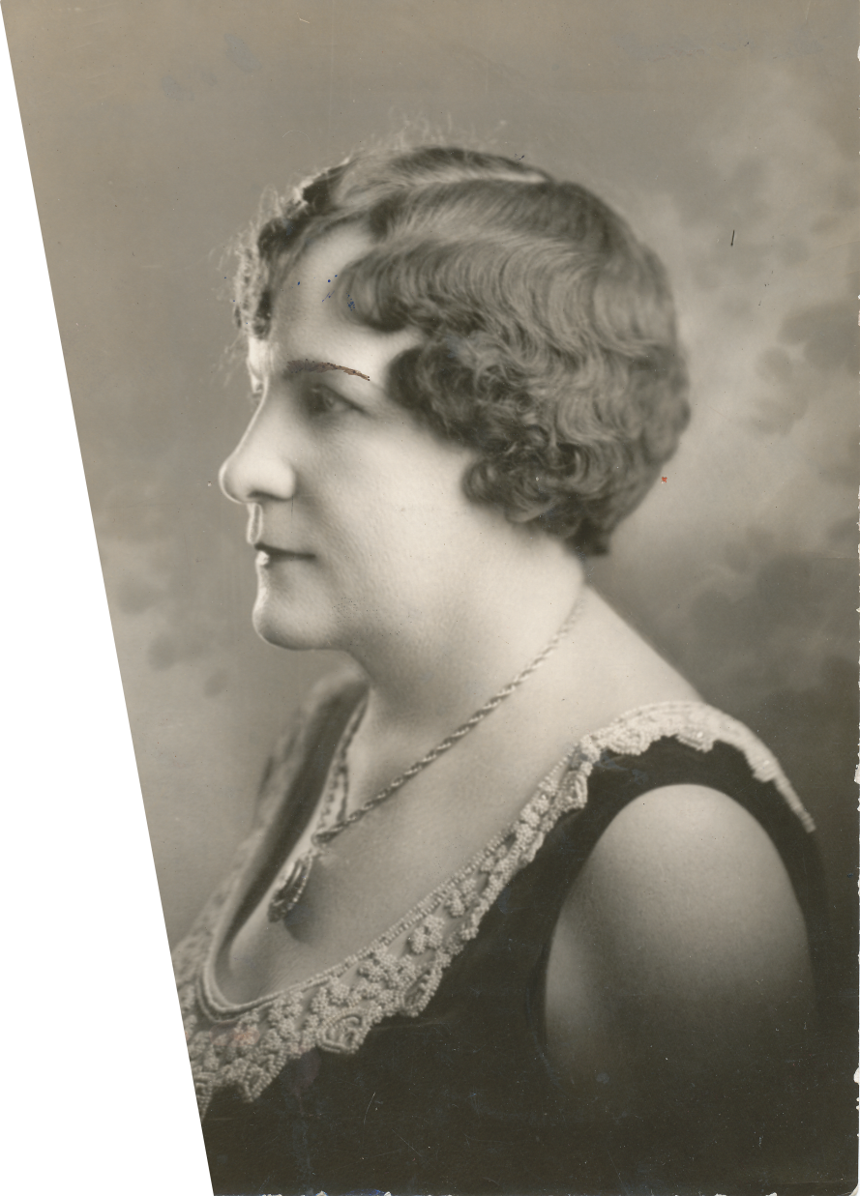
Mamie Sue Bastian
Our Founders
Taught all grades and subjects in elementary school – loved arithmetic
Served as principal in several elementary schools
Worked untiringly for a teacher retirement system, finally successful
Formed Houston Teachers and Houston Principals Associations
Brought laughter into any room she entered; loved fun and music
Initiated the Birthday Luncheon
Notes:
Remembered always for her vivacious and fun-loving personality, Mamie Sue Bastian worked untiringly for the teacher retirement system, a goal that finally came to fruition. Persuasive and often blunt, she appeared before countless legislative committees on behalf of teachers’ issues, particularly to fight discrimination against women.
Teaching all grades and all subjects in elementary schools, she admitted that her favorite subject was arithmetic. She left the classroom for a principal’s position and quickly realized that both teachers and administrators could realize professional improvement through organizations. Thus, the Houston Teachers Association and the Houston Principals Association were born. In the later years of her professional career, she became an inspirational teacher of teachers.
Mamie Sue Bastian was the epitome of buoyant living, of the humorous remark, of infectious optimism. She valued the “frivolous, the things of the heart.” So, it is no surprise that she initiated the idea of the Birthday Luncheon and encouraged adding music to all events.

Slide 8
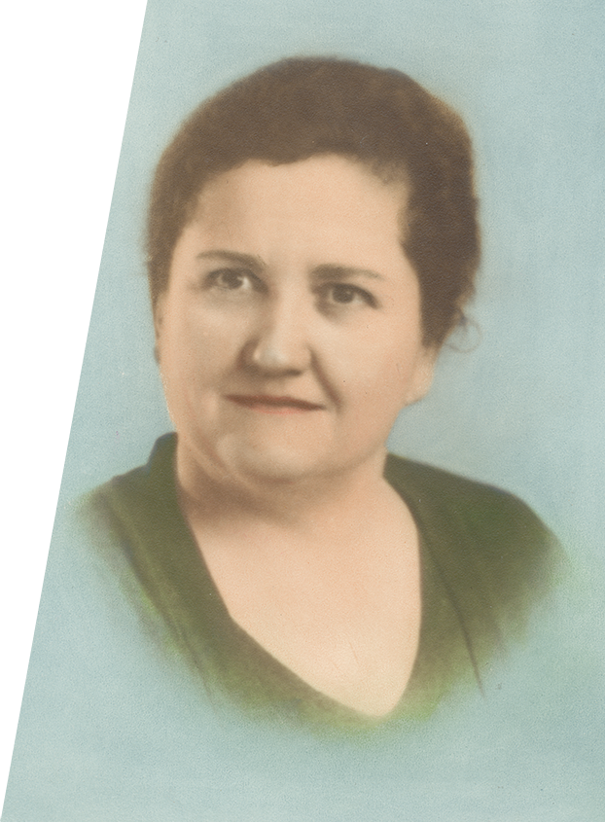
Ruby Cole
Our Founders
December 2, 1893-November 21, 1940
Notes:
Ruby Cole

Slide 9
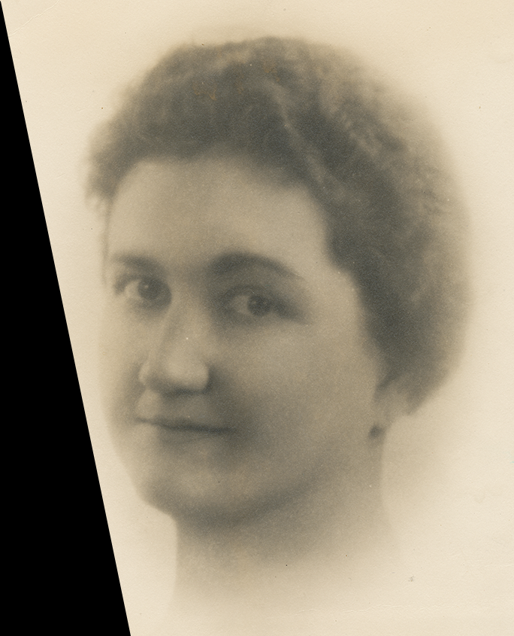
Ruby Cole
Our Founders
Dedicated, methodical principal, always working for adequate funding for public schools
Thorough and meticulous in creating DKG materials for chapter presidents – a perfectionist
Encouraging in getting DKG to work with other civic organizations for common goals
Indefatigable in working for restoration of missions, establishment of parks and creation of public library in San Antonio
Loved her dogs, reading, playing bridge and entertaining
Notes:
Known for her thorough and meticulous habits, Ruby Cole was a perfectionist. Delta Kappa Gamma reaped the benefits of these qualities, for in the beginning of the Society, she worked on the processes, structure and rituals for chapter use. Then each chapter president received mimeographed materials which she was expected to follow.
In the same way, as a principal, Ruby Cole was methodical and diplomatic in working with her teachers. She was passionate in working for adequate funding for public schools. She, more than any other founder, encouraged chapters to work with other civic organizations to realize common goals.
San Antonio benefited from her dedication to restore missions, establish parks, purchase historical landmarks, and create a public library.
She loved her dogs – Lucky and Lady, reading, collecting Texas histories, playing bridge, and entertaining guests.

Slide 10
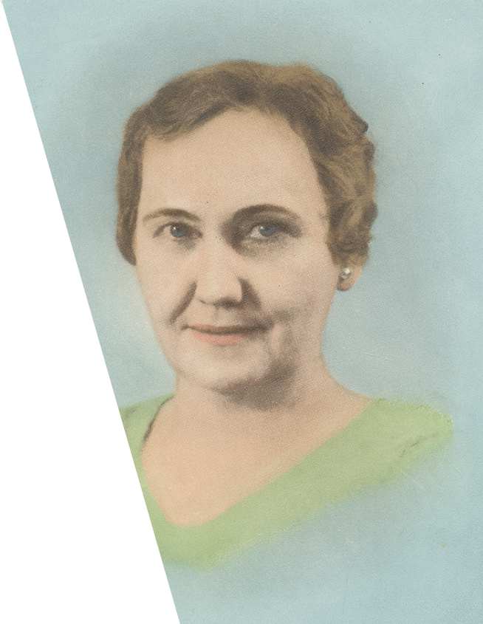
Mabel Grizzard
Our Founders
March 22, 1888-July 12, 1968
Notes:
Mabel Grizzard

Slide 11
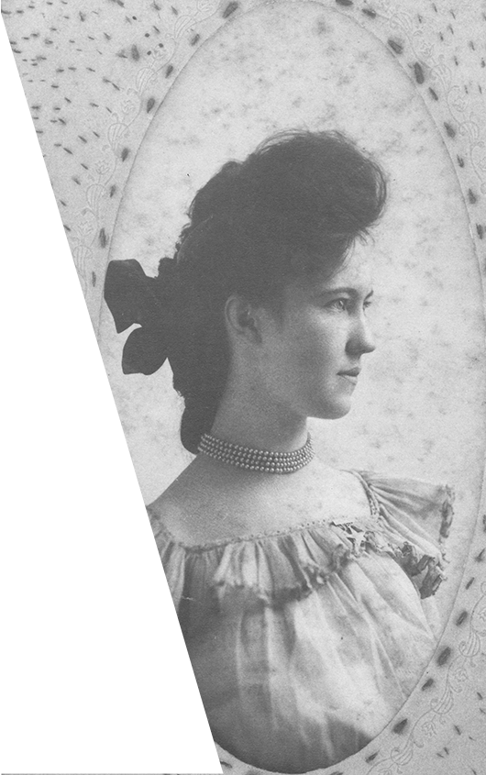
Mabel Grizzard
Our Founders
Served as teacher and principal in Waxahachie for more than 40 years
Recognized in her community for contributing to welfare of youth
Spent summers observing innovative teacher training methodology
Spent 2 years as elementary supervisor of Texas rural schools
Enjoyed reading, playing bridge, collecting old books and commemorative plates
Notes:
A teacher and principal for forty years, Mabel Grizzard contributed much to education as a whole and to her community – Waxahachie – in particular. She balanced her interest in participating in a variety of organizations with her dedication to the welfare of youth.
As a teacher and as a principal, it was her philosophy that the overall purpose of education was to establish character. So, it was important to teach the basics and develop good citizens. Nonetheless, she spent many summers attending colleges and universities in order to keep abreast of teacher training methods. She also spent a two-year tenure as elementary supervisor of rural schools in Texas.
Reading, playing bridge, collecting old books and commemorative plates: these activities filled her leisure time.

Slide 12
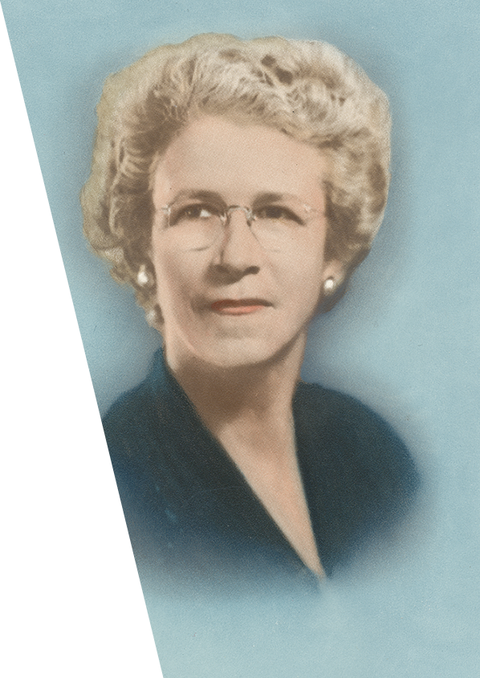
Dr. Anna Hiss
Our Founders
May 11, 1892-January 29, 1972
Notes:
Dr. Anna Hiss

Slide 13
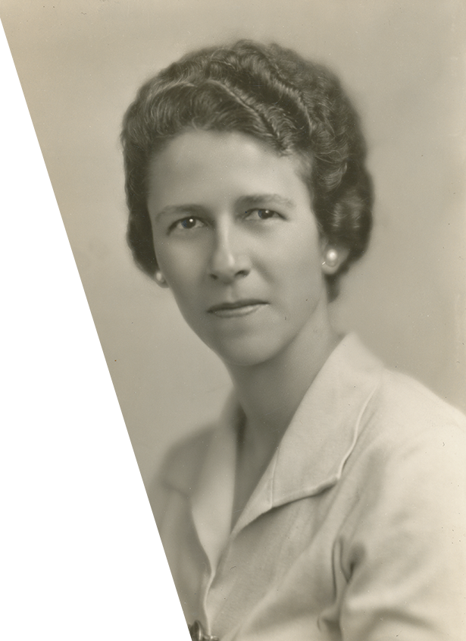
Dr. Anna Hiss
Our Founders
Head of the University of Texas Physical Education Department
Instrumental in establishing professional degree for Physical Education
Member of many organizations; honored by those and many others
A teller of original stories, a reader of poetry, horseback rider, and, of course, sportswoman, especially in basketball.
Notes:
One of the most outstanding administrators ever on the campus of the University of Texas, Dr. Anna Hiss served as Head of the Physical Education Department. A practical idealist, Dr. Hiss paid attention to the needs of her students, at one time teaching some of the rural women under her tutelage the necessary social graces by holding a formal dance in the gymnasium. When the Depression hit, the dances were discontinued, but she formed student relief groups to help the most needy.
Dr. Hiss felt that physical education was as important for women as for men, and she spent her career creating programs and opportunities to fulfill that need. In fact, she was instrumental in the establishment of the professional degree for physical education and the program for the preparation of teachers in that field. Perhaps the proudest accomplishment in her professional career came when her dream of a gymnasium for women came to fruition.
Organizations were important entities in her life; she believed in their power to change and improve the world. As one example, she founded the League of Women Voters on the UT campus.
She had a flare for telling entertaining stories to audiences of all ages; she loved poetry and music. And, of course, she loved sports, especially basketball.

Slide 14
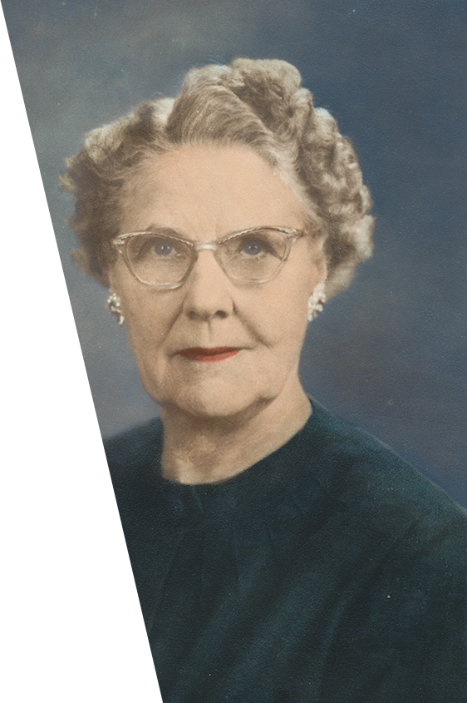
Ray King
Our Founders
July 13, 1888-January 4, 1979
Notes:
Ray King

Slide 15
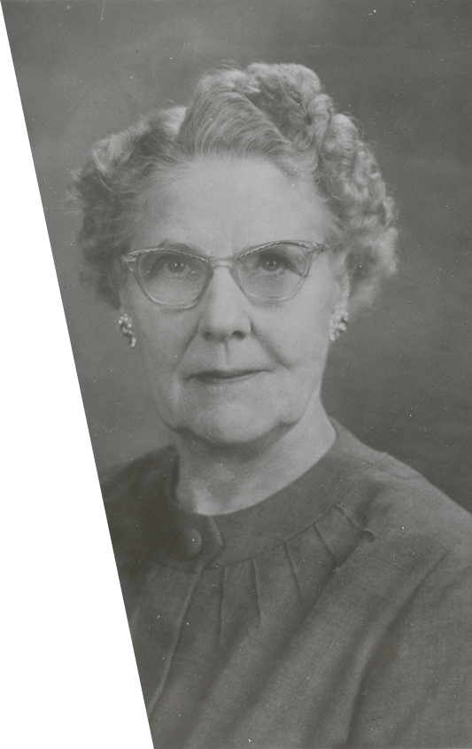
Ray King
Our Founders
Served as first treasurer of the Society
Participated in ground-breaking and laying of the cornerstone of the Society Headquarters in Austin, Texas
Believed in this formula:
Idea + Vision + Faith + Work = magic
Taught history and chaired high school department
Studied and traveled her entire life
Favored reading as a favorite pastime but loved cooking and playing bridge
Notes:
The first treasurer of Delta Kappa Gamma, Ray King took great joy in balancing the books each year of her four-year tenure in the position. She served in many Society capacities over the years, but perhaps her most thrilling moment was her participation in the ground-breaking ceremonies and the laying of the cornerstone for the International Headquarters.
A history teacher, Ms. King served as chair of her high school department for many years. She supplemented on-going study in her field with much travel throughout the United States, Canada and Mexico.
Her magic formula for Society success was this: idea + vision + faith + work; this brought Delta Kappa Gamma from simple beginnings to a sturdily based international organization.
Her favorite pastime was, not surprisingly, reading, but she also loved to needlepoint, tend her African violets and cook delectable foods.

Slide 16
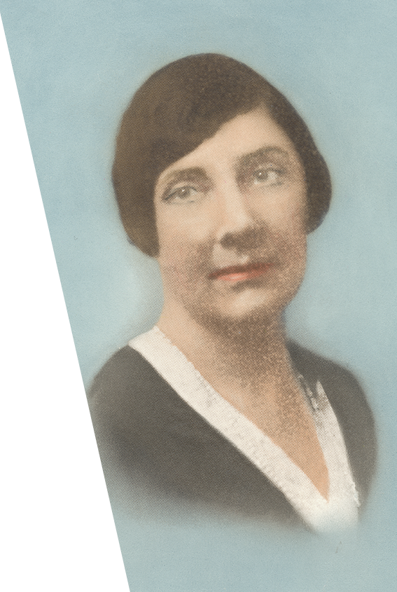
Sue King
Our Founders
January 8, 1886-May 4, 1930
Notes:
Sue King

Slide 17
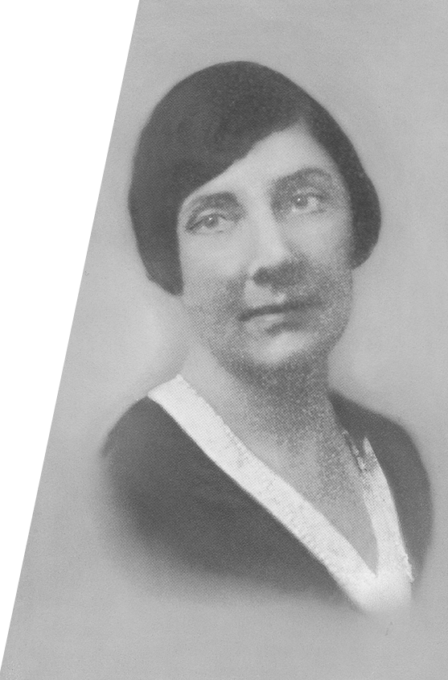
Sue King
Our Founders
Known as excellent scholar and leader; loved history and languages
Taught Latin, then history as chair of Junior High History department
Instrumental in Dr. Blanton’s election as president of Texas State Teachers Association
Loved reading, cooking, playing bridge and tennis
Died one year after founding of the Society
Notes:
An excellent scholar and a good leader, Sue King contributed much to the Society. Though she loved learning in all areas, her special favorites were history and languages. She was one of six graduates from the University of California in her class who earned high honors. Most of her summers were spent studying and expanding her knowledge.
Beginning as a Latin teacher, she found she enjoyed history instruction more and became chair of the history department in her junior high school.
Miss King was instrumental in Dr. Annie Webb Blanton’s election as president of Texas State Teachers Association. “Now a woman will wield the gavel and man must take orders.”
Aside from participating in the other organizations of which she was a member, she enjoyed reading, cooking, as well as playing bridge and tennis.
She died in May 1930, one short year after the founding of Delta Kappa Gamma.

Slide 18
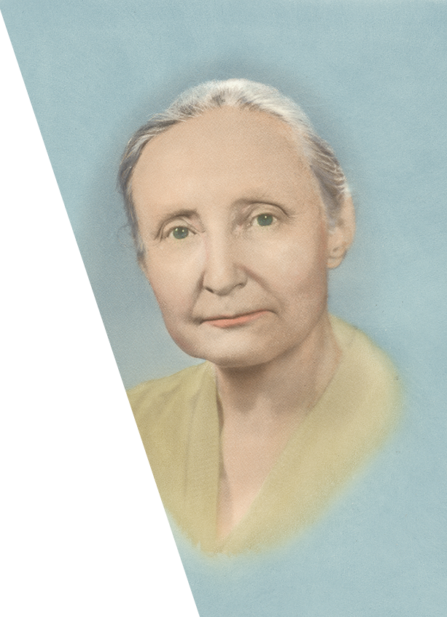
Dr. Helen Koch
Our Founders
August 26, 1895-July 14, 1977
Notes:
Helen Koch

Slide 19
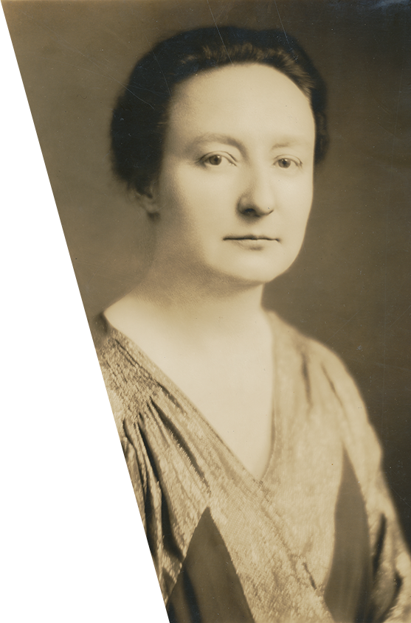
Dr. Helen Koch
Our Founders
Renowned professor of child psychology at University of Chicago
A perfectionist who valued her students
A dreamer who hoped that DKG would become an international organization as a way to protect children around the world
A gifted pianist, she taught children to play piano
A world traveler who delved into cultures
Notes:
Renowned professor of child psychology at the University of Chicago, Dr. Helen Koch found great satisfaction in research. She never compromised her high standards in her own study or as a teacher. And her students loved her for that perfectionist attitude. Working with her, a student felt both dignified and honored. She conducted a 12-year study on twins that is still quoted in the literature of child psychology.
A gifted pianist, she studied and practiced for fourteen years in her own home, then decided that she would rather be a psychologist than a piano teacher. However, she continued to teach piano lessons at the University of Chicago Settlement.
Dr. Koch viewed Delta Kappa Gamma as an organization that could improve the lives of women educators and children. Her dream was that the Society would become an international organization able to “dissipate any condition which [would] seriously threaten the welfare of children anywhere…”
Traveling extensively both during her tenure as professor and during her retirement, she took great joy in being a “globe-trotter.”

Slide 20
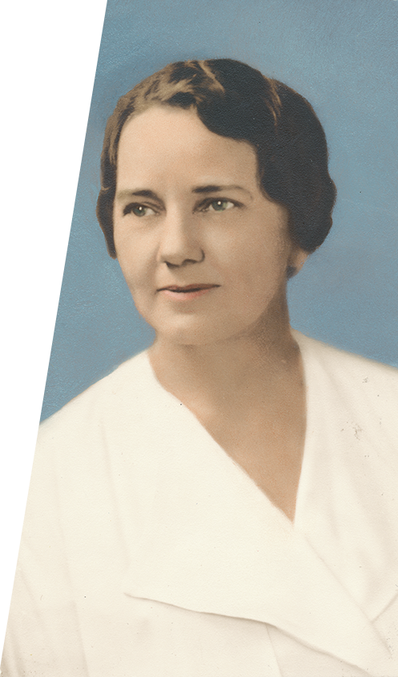
Ruby Terrill Lomax
Our Founders
February 7, 1886-December 28, 1961
Notes:
Ruby Terrill Lomax

Slide 21
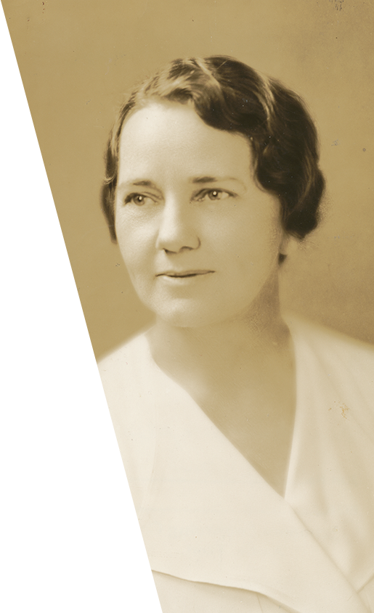
Ruby Terrill Lomax
Our Founders
Brilliant scholar
Dean of Women and Associate Professor of Classical Languages at University of Texas
Assistant to her husband, John Lomax, in collecting folk ballads
First parliamentarian of the Society
A welcome, enjoyable speaker to audiences
Notes:
A brilliant scholar, Ruby Terrill Lomax earned the highest average ever achieved by anyone at the University of Texas when she graduated in 1908. After teaching Latin at Dallas High School and at East Texas State Teachers College, she returned to UT as Dean of Women and Associate Professor of Classical Language.
She married John Lomax, well known for his lectures and collection of folk ballads, gaining four well-loved stepchildren. Mrs. Lomax enthusiastically joined in his research and accompanied on his many research travels.
During the first election of state / national officers, Mrs. Lomax was made parliamentarian. With her keen knowledge, she effectively guided the fledgling organization with integrity.
Mrs. Lomax truly enjoyed speaking before audiences, entertaining and enlightening them with her intellect and wit.

Slide 22
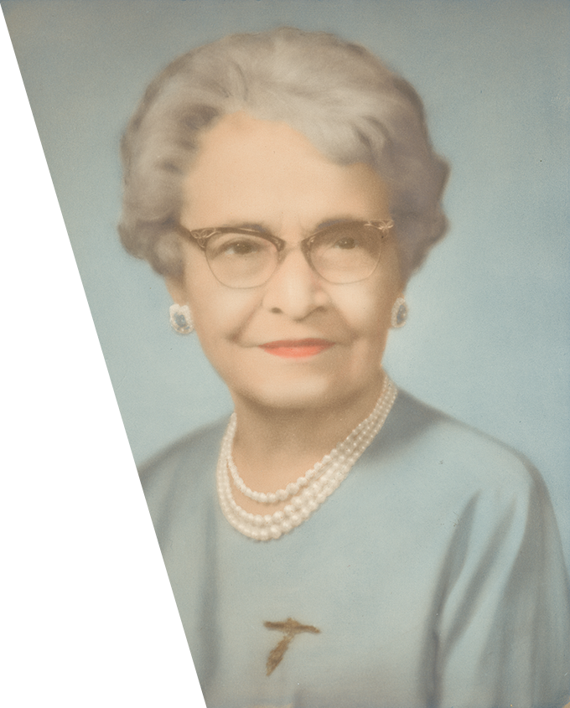
Dr. Cora Martin
Our Founders
November 27, 1884-April 23, 1965
Notes:
Dr. Cora M. Martin

Slide 23
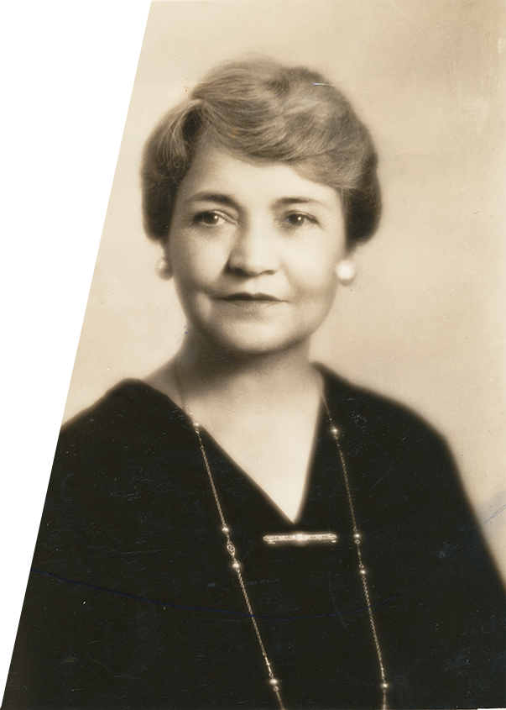
Dr. Cora Martin
Our Founders
Organized the Department of Elementary Education at the University of Texas
Believed that content of readers should be meaningful to children, so wrote a series of books that reflected this philosophy
Selected “keeper of the records” after the founding of DKG
Involved in many installations of state organizations and chapters
Loved to sing, write, travel and read historical fiction
Notes:
An excellent leader and scholar on campus, Dr. Cora Martin studied to become a teacher of elementary education at North Texas State Normal. Continuing her academic and professional career, she moved to Austin to attend the University of Texas. There she organized the program of Elementary Education.
Dr. Martin believed that content of readers should be meaningful to children, so she wrote a series of five Real Life Readers later adopted by Texas, Louisiana and Alabama. After 26 years of training new elementary teachers, she was given the permanent status of professor emeritus of elementary education when she retired from UT. Many of her students saw that as a teacher, she was able to bring out the best in every child.
Following her initiation into Delta Kappa Gamma at the first initiation ceremony, she was selected to be the “keeper of the records” for the Society. She was very involved in installing both new state organizations and new chapters in Texas.
With a lovely singing voice, she enjoyed entertaining audiences as well as leading the singing in meetings. She also enjoyed reading historical novels and found creative writing an interesting pastime.

Slide 24
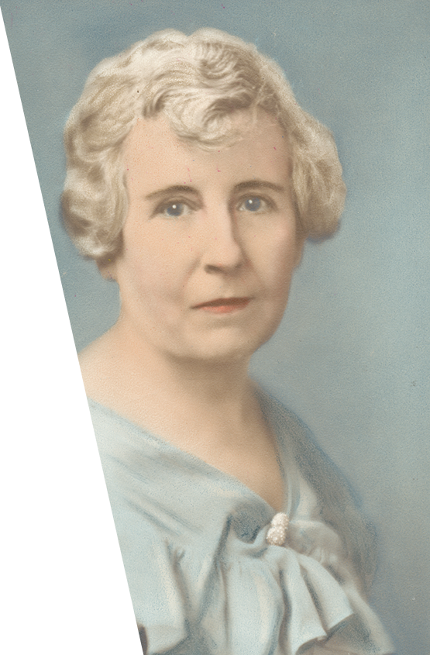
Lalla M. Odom
Our Founders
April 8, 1874-April 13, 1964
Notes:
Lalla M. Odom

Slide 25
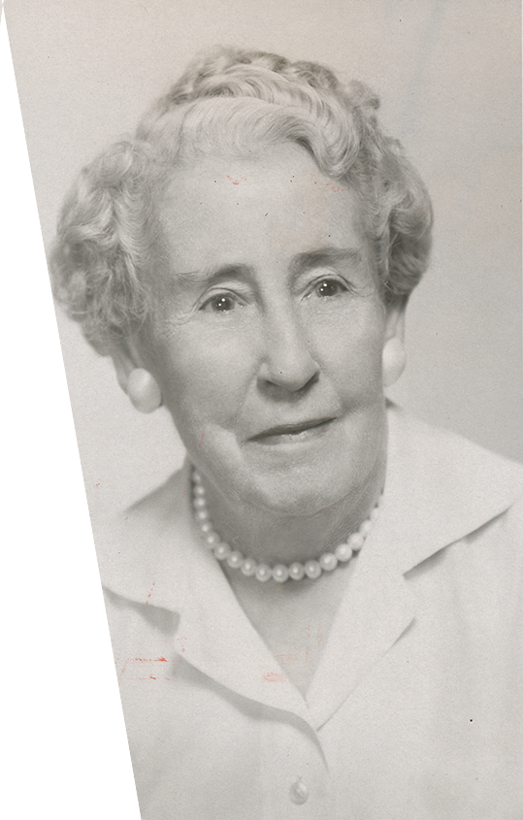
Lalla M. Odom
Our Founders
Earned a degree from the Conservatory of Music in Cincinnati, Ohio
Taught famed humorist Will Rogers and maintained a friendship with him
Refused to accept discrimination when told she could not be hired as a teacher because of her marital status − Board changed the policy
Served as teacher of mathematics and chair of Department at junior high level
Turned first spade-full of earth for headquarters building
Loved her sons, Texas, wildflowers and politics
Notes:
After earning her bachelor’s degree by age 17, Lalla M. Odom enrolled in the Conservatory of Music in Cincinnati. As a music and math teacher at Willie Halsell College in Oklahoma, she met her famous student: humorist Will Rogers, who remained a friend to her all his life.
After her marriage, Mrs. Odom’s family moved to Austin where she taught elementary school. At the end of that highly successful year, she was informed that she could not be offered a teaching position because she was a married woman; she could, however, work as a substitute. Always an outspoken person, she refused to accept this situation, and the School Board reversed its original policy.
She spent the rest of her career as a teacher of mathematics and chair of the department at Allan Junior High. She was a lifelong learner who constantly sought to expand her knowledge.
Very active in Delta Kappa Gamma activities, she served as Alpha Chapter’s first president, and she had perfect attendance for the first ten years. Later, the first spade-full of earth for the headquarters building in Austin was turned by Mrs. Odom.
Her loves included her two sons (Will and Jamie), Texas and its cultural background, wildflowers, and politics.

Slide 26
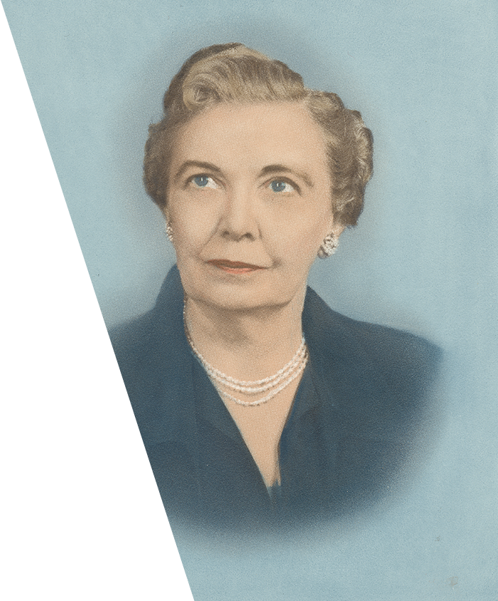
Lela Lee Williams
Our Founders
July 20, 1883-February 18, 1971
Notes:
Lela Lee Williams

Slide 27
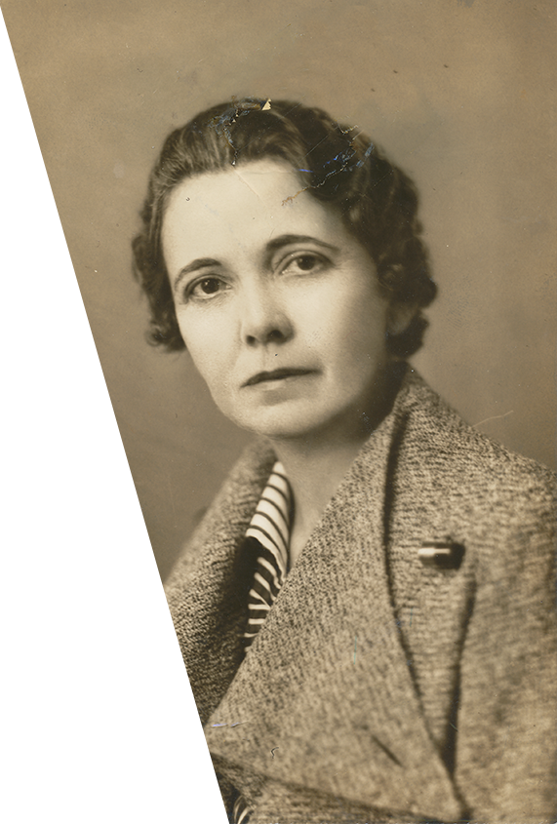
Lela Lee Williams
Our Founders
Associated with Dallas, Texas, schools for 45 years
Dedicated to improving the education profession
Appointed Director of Auditorium Activities and wrote a book on the subject
Served as first recording secretary of the Society
Enjoyed inviting friends and colleagues to her home
Notes:
Dallas, Texas, welcomed Lela Lee Williams to its schoolrooms in1908, and she spent the next 45 years serving the students there in a variety of positions. She believed in experimentation, always seeking to expand her knowledge and skills so that she could improve teaching. She served as the first president of the Dallas Grade Teachers Association.
Miss Williams felt a particular passion for the advancement of the profession of elementary teachers. To this end, she worked for stronger certification requirements, increasing the basic education required for teachers, and upgrading rural schools. She was instrumental in promoting increased salaries for educators.
In addition to her teaching load, she was Director of Auditorium Activities, and she became very active in this field, writing a book to assist others who held such a position.
The first recording secretary of the Society, Miss Williams understood from the beginning that Delta Kappa Gamma had the potential to offer much of value to women educators.
Aside from her love of education, she enjoyed entertaining her many friends and colleagues.

Slide 28
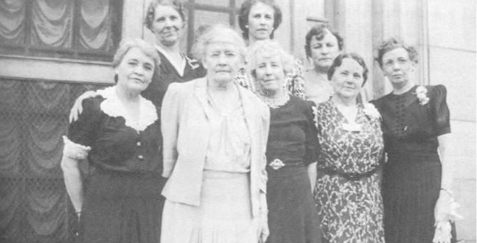
Let us live the legacy that these visionary women began.
Our Founders
Let us continue to
Clarify the vision of the Society
Have enduring faith in the work of the Society
Find the courage to review, question and refine precedents
Notes:
Conclusion
As we consider the many achievements of our founders, let us live the legacy that these visionary women began. Let us continue to clarify the vision of the Society, have enduring faith in the work of the Society, and find the courage to review, question and refine precedents. Thus, we will expand Delta Kappa Gamma’s positive impact across the globe.

